Slide 1
Efficient Anomaly Detection via Matrix Sketching ﻿32nd Conference on Neural Information Processing Systems (NeurIPS 2018), Montréal, Canada.
Vatsal Sharan﻿ Stanford University vsharan@stanford.edu | ﻿Parikshit Gopalan VMware Research pgopalan@vmware.com | ﻿Udi Wieder VMware Research uwieder@vmware.com
PPT maker: 謝幸娟 (Hsing-Chuan Hsieh)
connie0915549431@hotmail.com

Slide 2
1. Introduction

Slide 3
1. Introduction
Context
﻿Anomaly detection (AD) in high-dimensional numeric (streaming) data is a ubiquitous problem in machine learning
﻿E.g., parameters regarding the health of machines in a data-center
﻿Popular PCA/subspace based AD is used
E.g. of anomaly scores: rank-k leverage scores , rank-k projection distance…

Slide 4
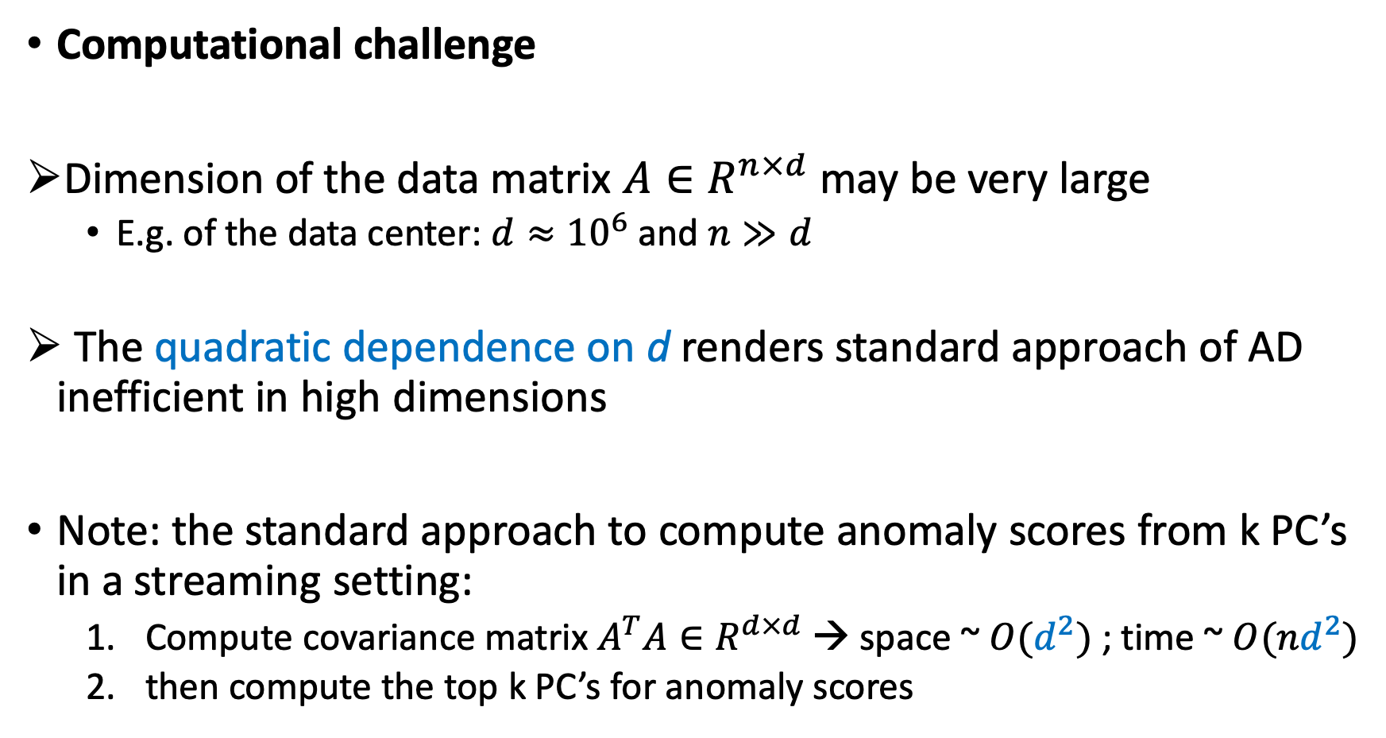
1. Introduction
Computational challenge
﻿Dimension of the data matrix $A∈R^{n×d}$may be very large
E.g. of the data center: $d≈{10}^{6}$ and $n≫d$
﻿ The quadratic dependence on d renders standard approach of AD inefficient in high dimensions
Note: the standard approach to compute anomaly scores from k PC’s in a streaming setting:
Compute covariance matrix $A^{T}A∈R^{d×d}$ → space ~ $O(d^{2})$ ; time ~ $O({nd}^{2})$
then compute the top k PC’s for anomaly scores

Slide 5
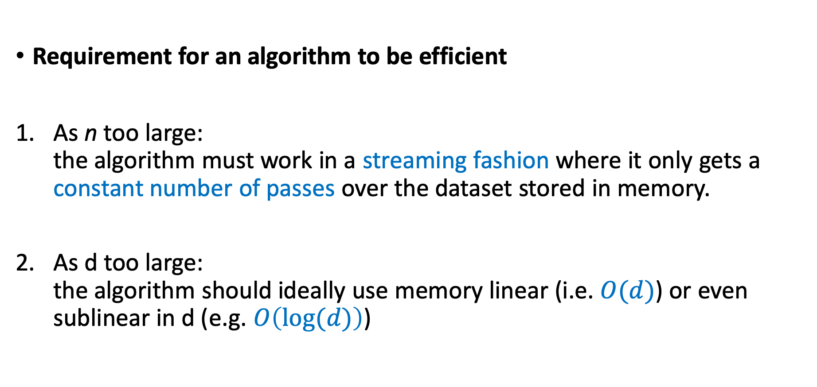
1. Introduction
Requirement for an algorithm to be efficient
As n too large: the algorithm must work in a streaming fashion where it only gets a constant number of passes over the dataset ﻿stored in memory.
As d too large: the algorithm should ideally use memory linear (i.e. $O(d)$) or even sublinear in d (e.g. $O\left(log⁡(d)\right)$)

Slide 6
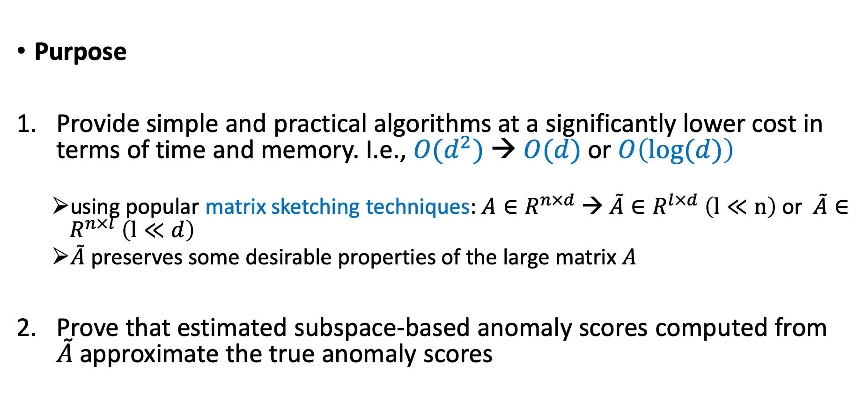
1. Introduction
Purpose
Provide simple and practical algorithms at a significantly lower cost in terms of time and memory. I.e., $O(d^{2})$ → $O(d)$ or$O\left(log⁡(d)\right)$
using popular matrix sketching techniques: $A∈R^{n×d}$ → $\tilde{A}∈R^{l×d} \left(l≪n\right)$ or $\tilde{A}∈R^{n×l} \left(l≪d\right)$
$\tilde{A}$ preserves some desirable properties of the large matrix $A$
Prove that estimated subspace-based anomaly scores computed from $\tilde{A}$approximate the true anomaly scores

Slide 7
2. Notation and Setup

Slide 8
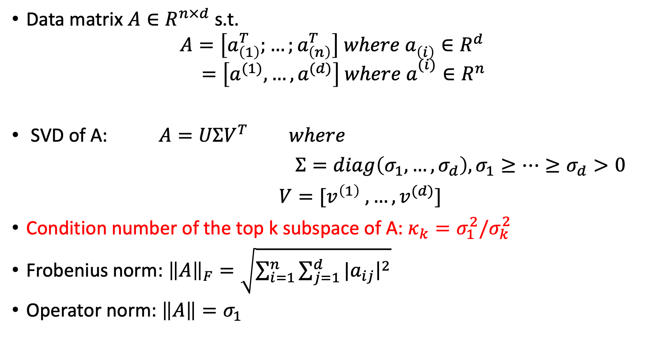
2. Notation and Setup
Data matrix $A∈R^{n×d}$ s.t.
$$A=\left[a_{\left(1\right)}^{T};…;a_{\left(n\right)}^{T}\right] where a_{\left(i\right)}^{}∈R^{d}$$
$$=\left[a^{(1)},…,a^{(d)}\right] where a_{}^{(i)}∈R^{n}$$
SVD of A: $A=UΣV^{T} where$
$Σ=diag\left(σ_{1},…,σ_{d}\right), σ_{1}≥…≥σ_{d}>0$
$V=[v^{\left(1\right)} ,…,v^{(d)}]$
﻿Condition number of the top k subspace of A: $κ_{k}=σ_{1}^{2}/σ_{k}^{2}$
﻿Frobenius norm: ${\left\|A\right\|}_{F}=\sqrt{\sum_{i=1}^{n}{\sum_{j=1}^{d}{{|a}_{ij}{\left.​\right|}^{2}}}}$
﻿Operator norm: $\left\|A\right\|=σ_{1}$

Slide 9
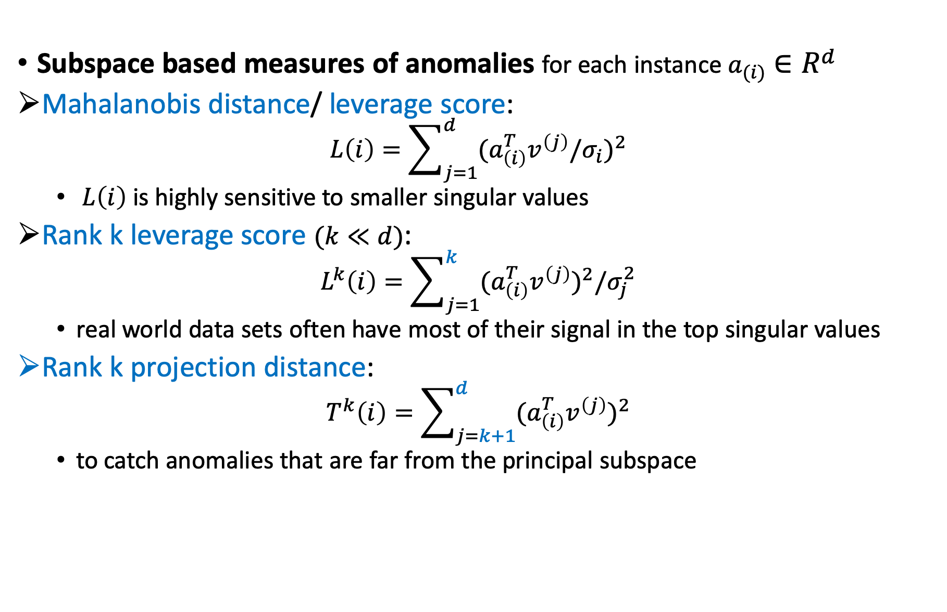
2. Notation and Setup
﻿Subspace based measures of anomalies for each instance $a_{(i)}∈R^{d}$
﻿Mahalanobis distance/ ﻿leverage score:
$$L\left(i\right)=\sum_{j=1}^{d}{{{(a}_{\left(i\right)}^{T}v^{\left(j\right)}/σ_{i})}^{2}}$$
﻿ $L\left(i\right)$ is highly sensitive to smaller singular values
﻿Rank k leverage score $(k≪d)$:
$$L^{k}\left(i\right)=\sum_{j=1}^{k}{{{(a}_{\left(i\right)}^{T}v^{\left(j\right)})}^{2}/σ_{j}^{2}}$$
real world data sets often have most of their signal in the top singular values
Rank ﻿k projection distance:
$$T^{k}\left(i\right)=\sum_{j=k+1}^{d}{{{(a}_{\left(i\right)}^{T}v^{\left(j\right)})}^{2}}$$
﻿to catch anomalies that are far from the principal subspace

Slide 10
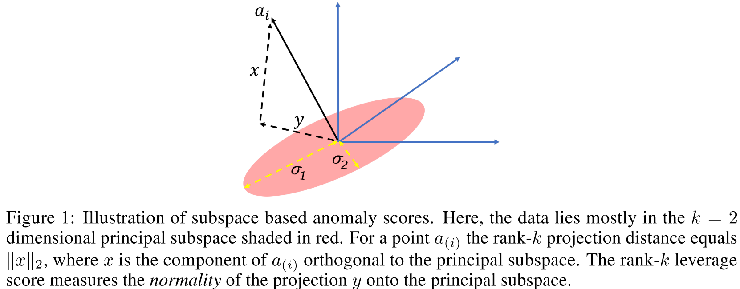

2. Notation and Setup
﻿Subspace based measures of anomalies for each instance $a_{(i)}∈R^{d}$
Illustration of Rank k leverage score/projection distance

Slide 11
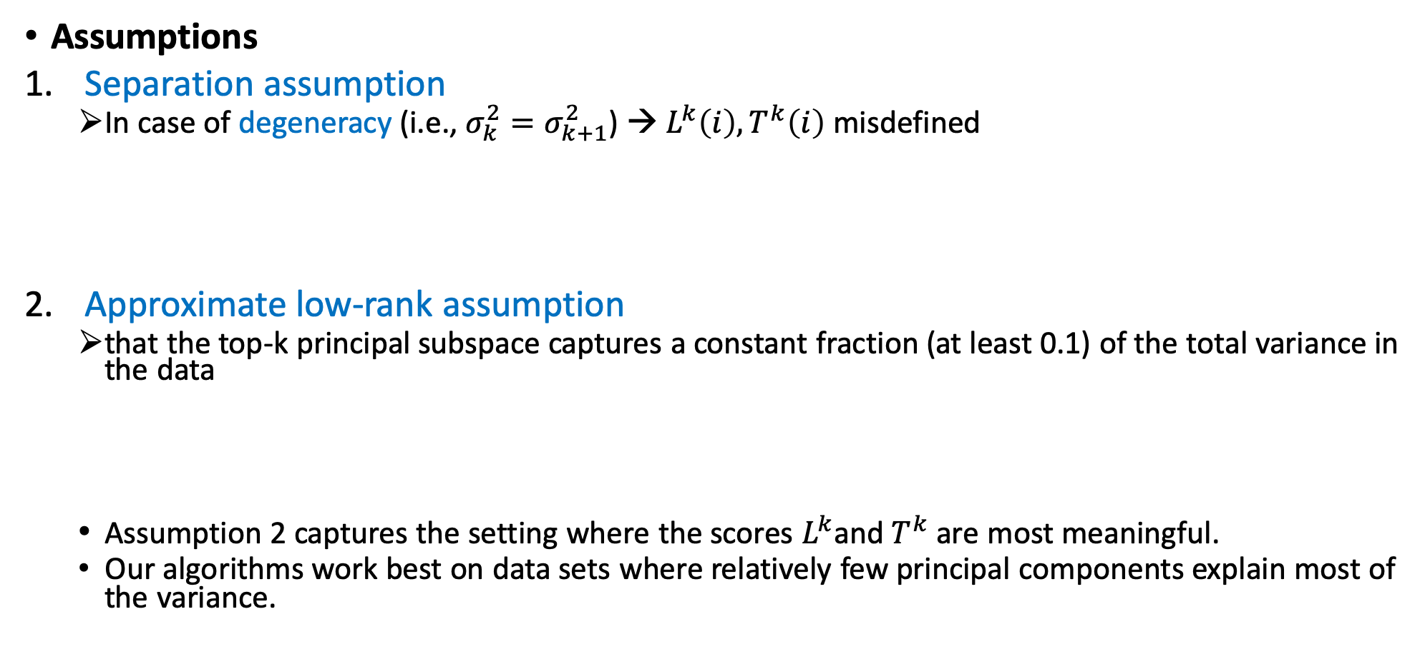
2. Notation and Setup
Assumptions
﻿Separation assumption
In case of degeneracy (i.e., $σ_{k}^{2}=σ_{k+1}^{2}$) → $L^{k}\left(i\right),T^{k}\left(i\right)$ misdefined
﻿Approximate low-rank assumption
﻿that the top-k principal subspace captures a constant fraction (at least 0.1) of the total variance in the data
﻿Assumption 2 captures the setting where the scores $L^{k}$and $T^{k}$ are most meaningful.
Our algorithms work best on data sets where relatively few principal components explain most of the variance.

Slide 12

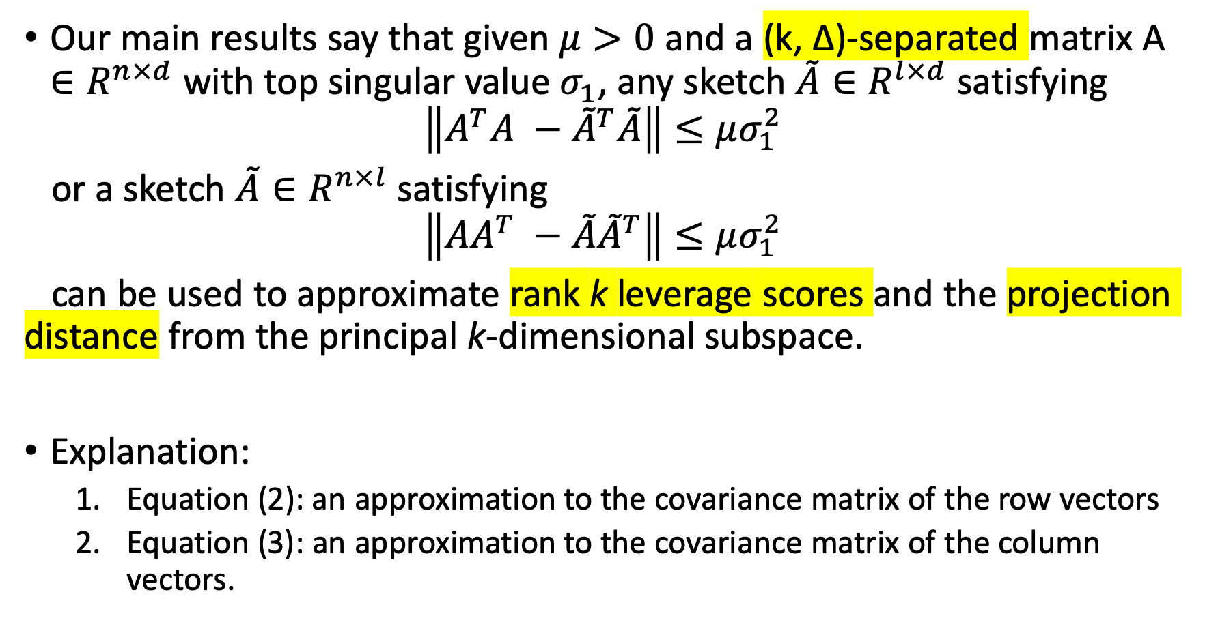

3. Guarantees for anomaly detection via sketching
Our main results say that given $μ>0$ and a ﻿(k, ∆)-separated matrix A $∈R^{n×d}$ with top singular value $σ_{1}$, any sketch $\tilde{A}∈R^{l×d}$ satisfying
$$\left\|A^{T}A −{\tilde{A}}^{T}\tilde{A}\right\|≤μσ_{1}^{2}$$
or a sketch $\tilde{A}∈R^{n×l}$ satisfying
$$\left\|AA^{T} −{\tilde{A}\tilde{A}}^{T}\right\|≤μσ_{1}^{2}$$
can be used to approximate rank k leverage scores and the projection distance from the principal k-dimensional subspace.
Explanation:
Equation (2): an approximation to the covariance matrix of the row vectors
Equation (3): ﻿an approximation to the covariance matrix of the column vectors.
(2)
d$×d$
(3)
$$n×n$$

Slide 13
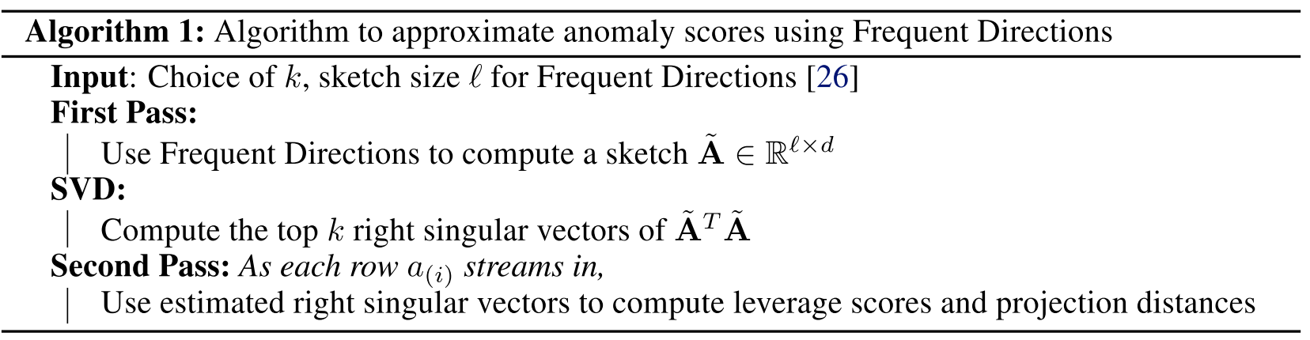
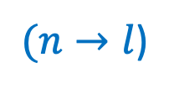
3. Guarantees for anomaly detection via sketching
Next, we show how to design efficient algorithms for finding anomalies in a streaming fashion.
﻿
Pointwise guarantees from row space approximations
Algorithm 1: random column projection/ row space approximation
Sketching techs: ﻿Frequent Directions sketch [18], row-sampling [19], random column projection, …
$(n→l$)

Slide 14
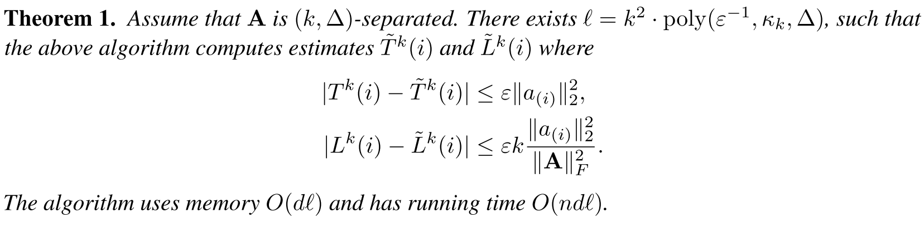


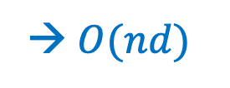
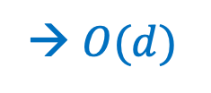
3. Guarantees for anomaly detection via sketching
﻿•Pointwise guarantees from row space approximations
﻿Thm 1 improves on the trivial $O(d^{2})$ bound of memory/ time
→ $O(d)$
→ $O(nd)$
,since $l$ is independent of d

Slide 15
3. Guarantees for anomaly detection via sketching
Next we show that substantial savings are unlikely for any algorithm with strong pointwise guarantees: there is an Ω(d) lower bound for any approximation

Slide 16
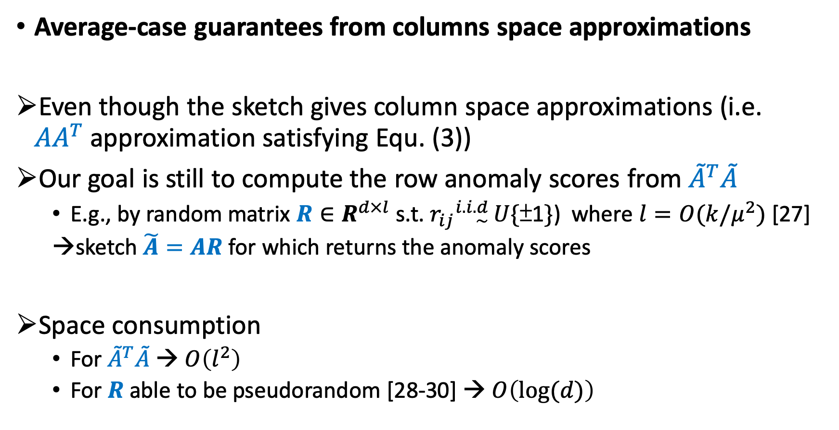
3. Guarantees for anomaly detection via sketching
﻿Average-case guarantees from columns space approximations
Even though the sketch gives column space approximations (i.e. $AA^{T}$approximation satisfying Equ. (3))
Our goal is still to compute the row anomaly scores from ${\tilde{A}}^{T}\tilde{A}$
E.g., by random matrix ${R∈R}^{d×l}$ s.t. $r_{ij}{}_{\sim }^{i.i.d}{ U\{\text{±1}\}}$) where $l=O(k/μ^{2})$ [27]
﻿sketch $\tilde{A}=AR$ for which returns the anomaly scores
Space consumption
For ${\tilde{A}}^{T}\tilde{A}$ → $O\left(l^{2}\right)$
For $R$ able to be pseudorandom [28-30] → $O\left(log⁡(d)\right)$

Slide 17
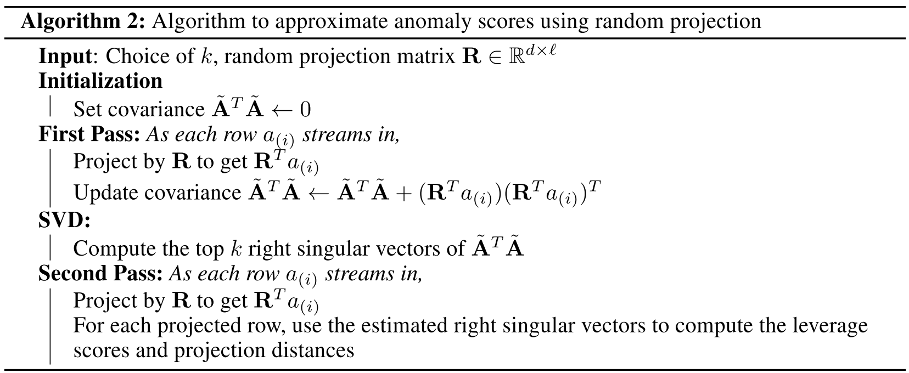
3. Guarantees for anomaly detection via sketching
﻿Average-case guarantees from columns space approximations
Algorithm 2: random row projection/ column space approximation

Slide 18
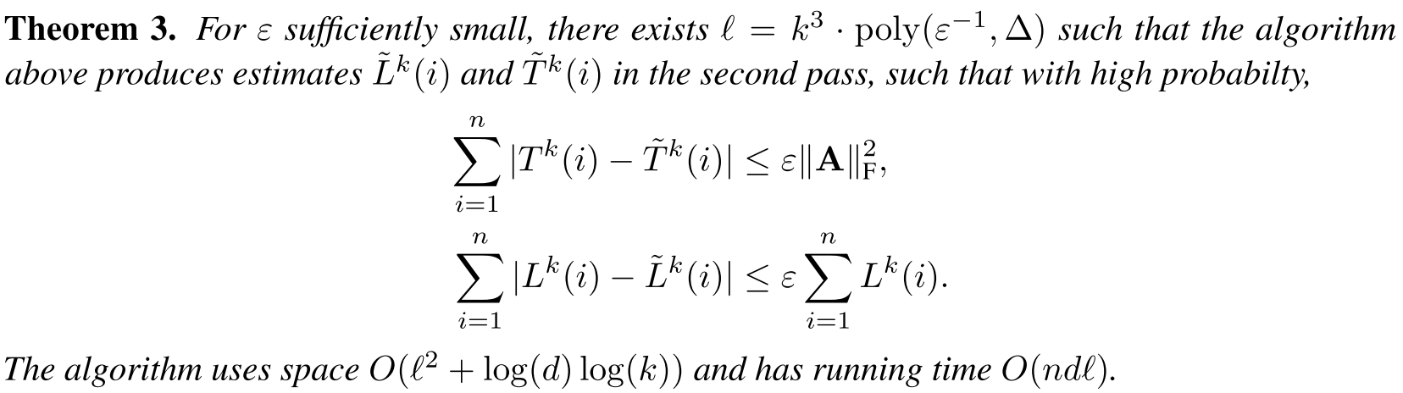

3. Guarantees for anomaly detection via sketching
﻿Average-case guarantees from columns space approximations
﻿i.e., on average random projections can preserve leverage scores and distances from the principal subspace
$l$ = poly(k, $ε^{−1}$, ∆), indep. of both n and d.

Slide 19
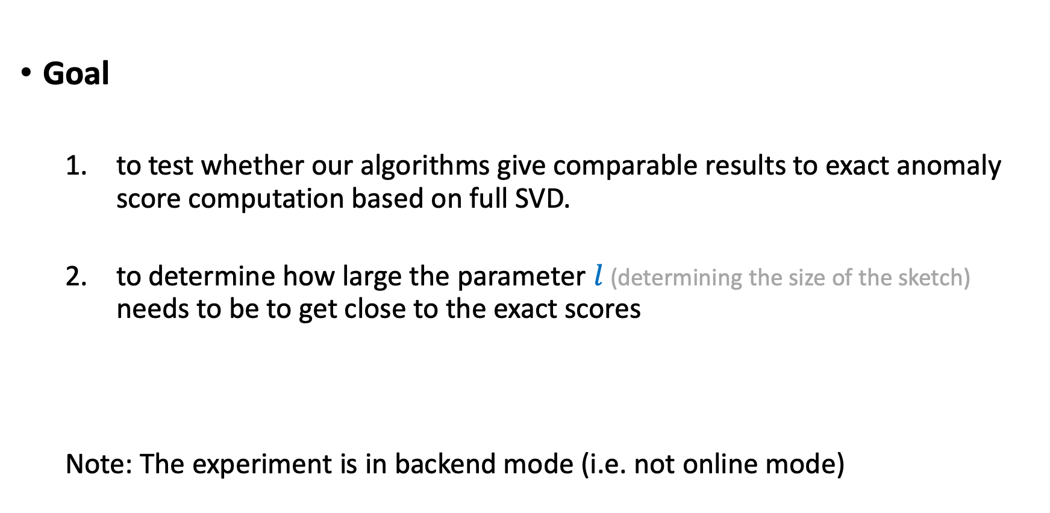
4. Experimental evaluation
Goal
to test whether our algorithms give comparable results to exact anomaly score computation based on full SVD.
to determine how large the parameter $l$ (determining the size of the sketch) needs to be to get close to the exact scores
Note: The experiment is in backend mode (i.e. not online mode)

Slide 20
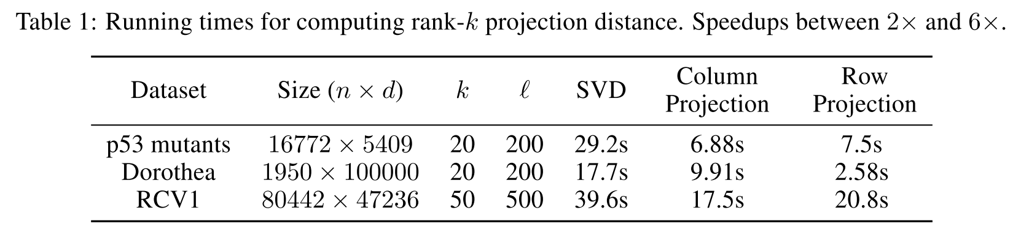
4. Experimental evaluation
Data: ﻿(1) p53 mutants [32], (2) Dorothea [33], (3) RCV1 [34]
All available from the UCI Machine Learning Repository,
Ground truth: to decide anomalies
﻿We compute the rand k anomaly scores using a full SVD, and then label the η fraction of points with the highest anomaly scores to be outliers.
k chosen by examining the explained variance of the datatset: ﻿typically between (10, 125)
η chosen by examining the histogram of the anomaly score; ﻿typically between (0.01, 0.1)

Slide 21
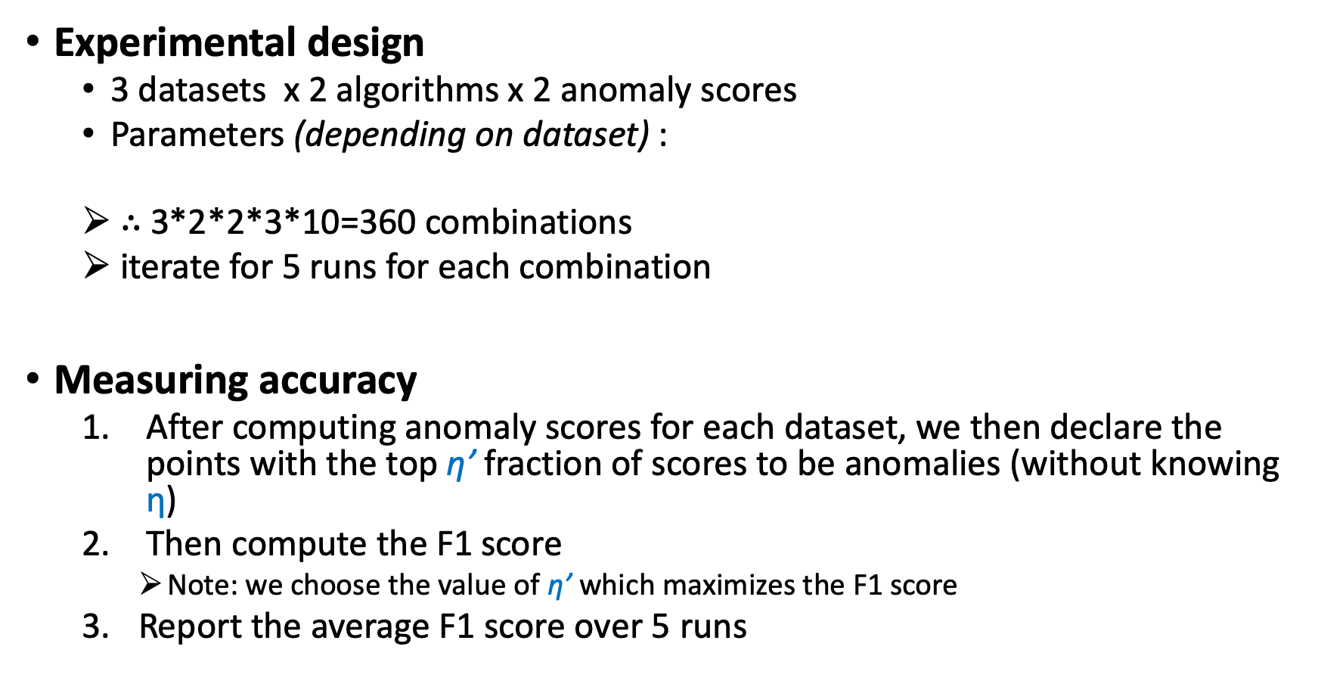
4. Experimental evaluation
Experimental design
3 datasets x 2 algorithms x 2 anomaly scores
Parameters (depending on dataset) :
$∴$ 3*2*2*3*10=360 combinations
iterate for 5 runs for each combination
Measuring accuracy
After computing anomaly scores for each dataset, we then declare the points with the top η’ fraction of scores to be anomalies (without knowing η)
Then compute the F1 score
Note: we choose the value of η’ which maximizes the F1 score
Report the average F1 score over 5 runs
k: 3 settings | $l$: 10 settings ranging (2k, 20k)

Slide 22
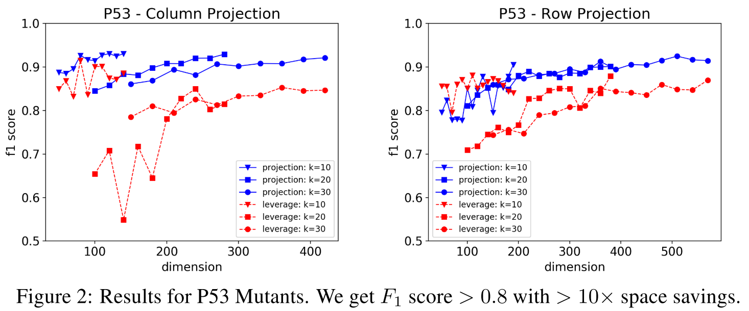
4. Experimental evaluation
Performance of dataset: p53 mutants

Slide 23
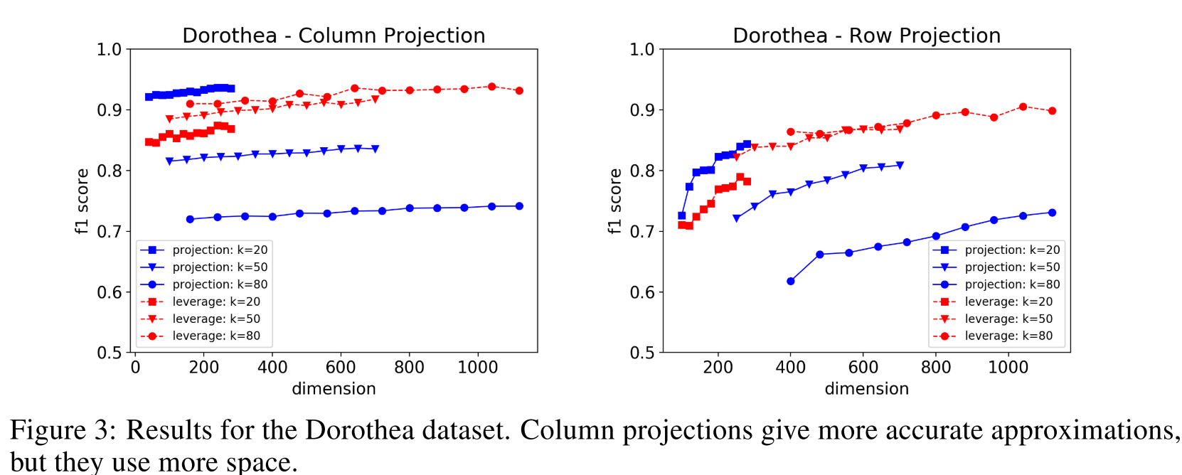
4. Experimental evaluation
Performance of dataset: Dorothea

Slide 24
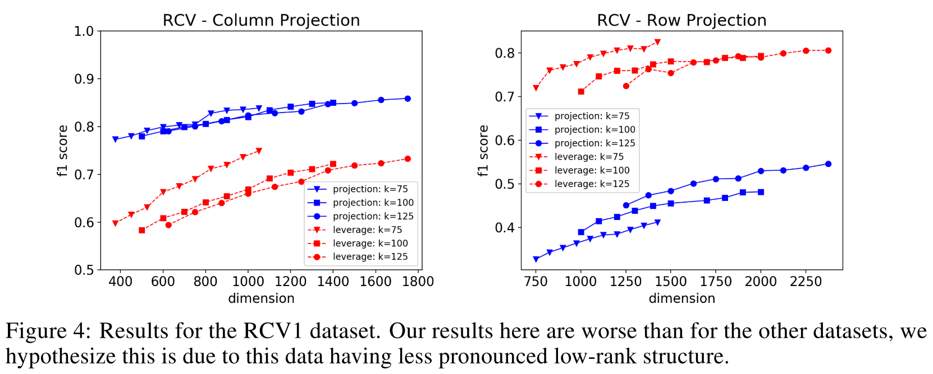
4. Experimental evaluation
Performance of dataset: RCV1

Slide 25

4. Experimental evaluation
Takeaways:﻿
Taking $l$ = Ck with a fairly small C ≈ 10 suffices to get F1 scores > 0.75 in most settings
﻿Algorithm 1 generally outperforms Algorithm 2 for a given value of $l$

Slide 26
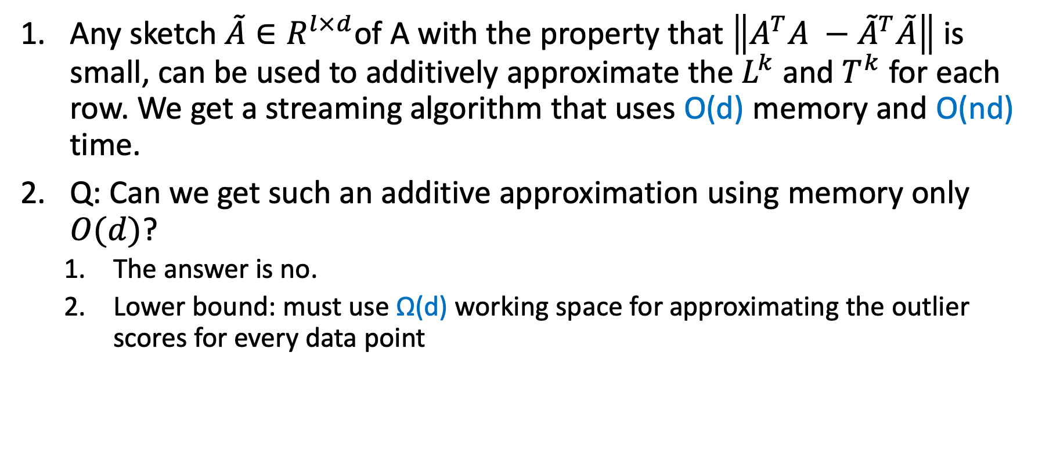
5. Conclusion
﻿Any sketch $\tilde{A}∈R^{l×d}$of A with the property that $\left\|A^{T}A −{\tilde{A}}^{T}\tilde{A}\right\|$ is small, can be used to additively approximate the $L^{k}$ and $T^{k}$ for each row. We get a streaming algorithm that uses O(d) memory and O(nd) time.
Q:﻿ Can we get such an additive approximation using memory only $O(d)$?
The answer is no.
Lower bound: must use Ω(d) working space for approximating the outlier scores for every data point

Slide 27
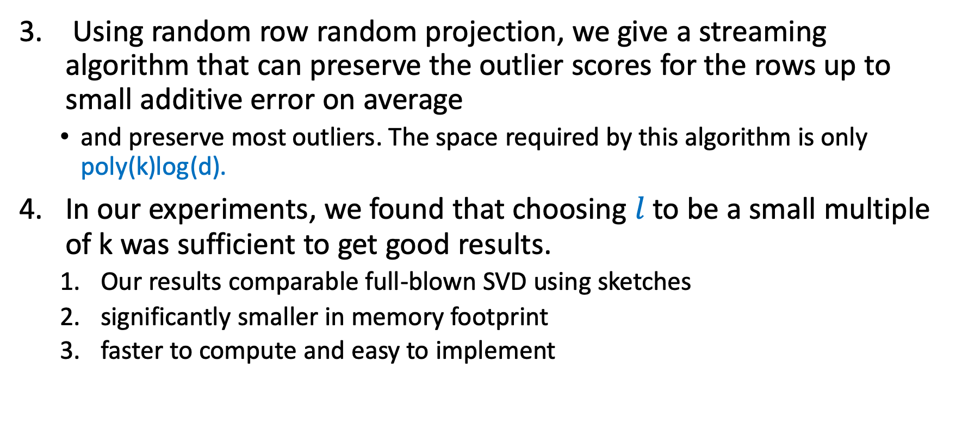
5. Conclusion
﻿ ﻿Using random row random projection, we give a streaming algorithm that can preserve the outlier scores for the rows up to small additive error on average
and preserve most outliers. The space required by this algorithm is only poly(k)log(d).
﻿In our experiments, we found that choosing $l$ to be a small multiple of k was sufficient to get good results.
Our results comparable full-blown SVD using sketches
significantly smaller in memory footprint
faster to compute and easy to implement

Slide 28
老師回饋
Code on Github?
SVD tool package
Is their experiment design reasonable?
How to apply to online-AD

Slide 29
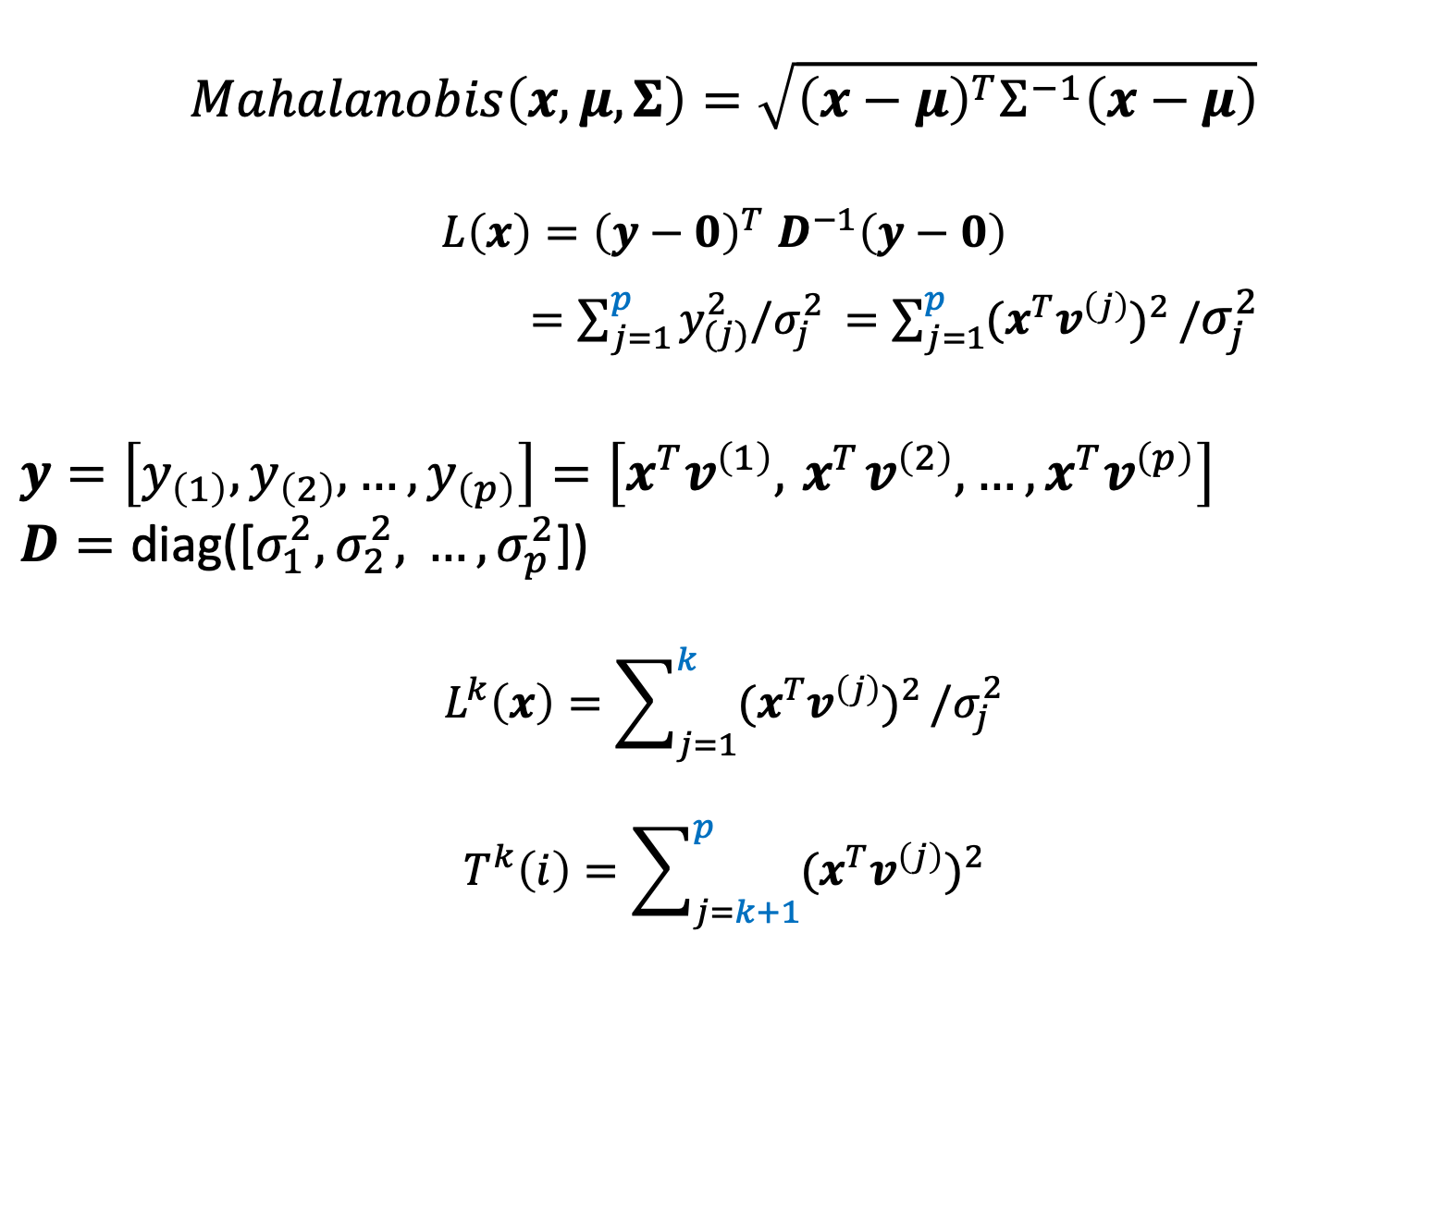
$$Mahalanobis\left(x, μ, Σ\right)=\sqrt{{\left(x−μ\right)}^{T}Σ^{−1}\left(x−μ\right)}$$
$$L\left(x\right){=\left(y−0\right)}^{T}D^{−1}\left(y−0\right)$$
$=\sum_{j=1}^{p}{y_{(j)}^{2}/σ_{j}^{2 }}=\sum_{j=1}^{p}{{(x^{T}v^{\left(j\right)})}^{2}}/σ_{j}^{2}$
$y=\left[y_{\left(1\right)},y_{\left(2\right)}, …,y_{\left(p\right)}\right]=\left[x^{T}v^{\left(1\right)},{ x}^{T}v^{\left(2\right)},…,x^{T}v^{\left(p\right)}\right]$
$$D=\text{diag}\text{([}σ_{1}^{2},σ_{2}^{2}\text{, }…,σ_{p}^{2}\text{])}$$
$$L^{k}\left(x\right)=\sum_{j=1}^{k}{{(x^{T}v^{\left(j\right)})}^{2}}/σ_{j}^{2}$$
$$T^{k}\left(i\right)=\sum_{j=k+1}^{p}{{(x^{T}v^{\left(j\right)})}^{2}}$$

